Slide 1
Module 5.2 / Week 10
Audit completion and review

Slide 2
Learning Objectives
  10.1 Explain the significance of the date of the auditor’s report.
  10.2 Define subsequent events of audit interest and describe the audit procedures applied specifically to identify such events.
  10.3 Describe the nature and purpose of written representations obtained from the entity’s management and solicitors.
  10.4 Explain the purpose and steps involved in reviewing the audit working papers and the financial report, including the final assessment of materiality and audit risk.
  10.5 Understand the auditor’s responsibilities in consideration of the entity’s ability to continue as a going concern.

Slide 3
LO 10.1
The date of the Auditor’s report

Slide 4
The date of the Auditor’s report
        Important because it establishes the date of the auditor’s responsibility for knowledge of events that should be reflected in the financial report.
        Auditor’s report should be dated when it is actually signed and no earlier than the date of directors’ declaration.
        Ensures financial report was completed and formally accepted by officers of the company prior to the auditor expressing an opinion.

Slide 5
Audit procedures after balance date
        Some audit procedures are performed after balance date as normal tests of balances, for example:
                cut-off tests
                collectability of accounts receivable determined by subsequent payment
                search for unrecorded liabilities.

Slide 6
Analytical procedures
        ASA/ISA 520.6 requires the auditor to apply analytical procedures at or near completion of the audit to:
        assist in overall review of reasonableness of financial report
        corroborate conclusions formed during audit
        ensure financial report as a whole is consistent with auditor’s knowledge of entity.

Slide 7
LO 10.2
Subsequent events

Slide 8
Subsequent events
        AASB 110 (IAS 10) indicates that financial reports should be prepared on the basis of conditions existing at balance date.
        However this may entail recognition of the financial effects of certain events that occurred after balance date and up until the time of completion.
        Under ASA/ISA 560 the auditor has a responsibility to ensure management discloses events occurring after balance date but prior to time of completion.
        Auditor must consider subsequent events up to the time they sign the auditor’s report.

Slide 9
Types of events subsequent to balance date
        Two types of events may materially affect financial reports:
                adjusting events
                non-adjusting events.

Slide 10
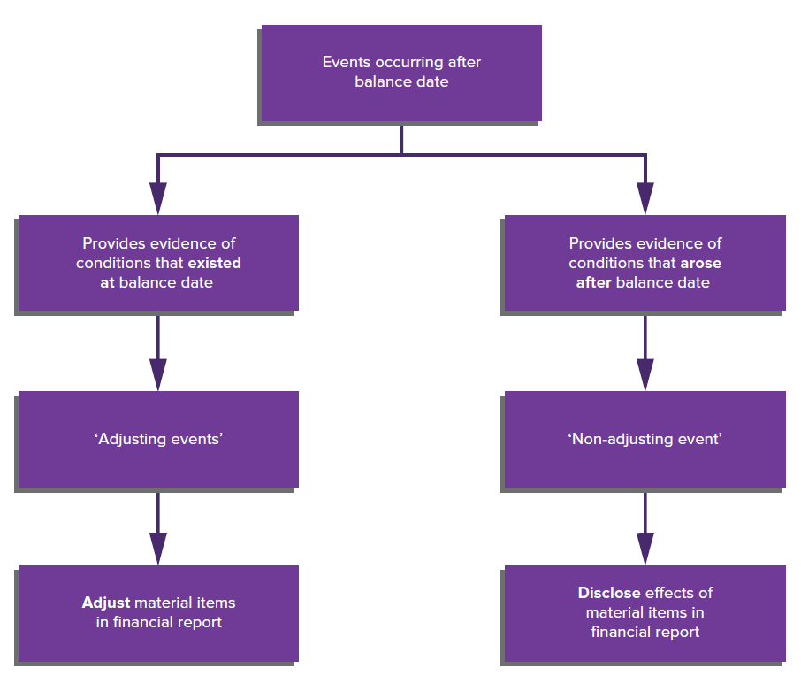
Summary of types of subsequent events
Source: Grant, G. & Simnett, R. (2018). Auditing & Assurance Services In Australia (7th Ed), Sydney, Australia: McGraw Hill

Slide 11
Adjusting events
        Events, both favourable and unfavourable, that provide evidence of, or further elucidate, conditions that existed at balance date.
        Financial effect of such events needs to be taken into account, therefore they require adjustment to the figures contained in the statement of financial position and/or the income statement.

Slide 12
Examples of adjusting events
        Subsequent collection of a material account receivable that has been treated as uncollectable at balance date.
        A legal determination, subsequent to balance date, that establishes that a claim was in existence, but of an uncertain amount, at balance date.
        Legislation after balance date that retrospectively changes the company income tax rate applying to financial period ended on or prior to balance date.
        Ascertainment subsequent to balance date of selling prices for inventory items, where those prices were previously uncertain.

Slide 13
Non-adjusting events
        Do not relate to a condition that existed at balance date.
        Include both favourable and unfavourable events that create new conditions, as distinct from any condition that might have existed at balance date.
        If material, disclose in the notes to the accounts.

Slide 14
Examples of non-adjusting events
        A fire or flood loss after balance date, not fully covered by insurance.
        A major currency realignment subsequent to balance date.
        Raising of additional shares or loan capital after balance date.
        Mergers and acquisitions after balance date.
        Expropriation, after the balance date, of a significant overseas investment or asset.

Slide 15
Events between balance date and the date of auditor’s report
        The auditor has a responsibility to apply audit procedures sufficient to enable auditor to determine whether all material adjusting and non-adjusting events have been appropriately adjusted for (adjusting) or disclosed (non-adjusting) in the financial report, up until the date of the auditor’s report.

Slide 16
Examples of procedures performed near the end of audit
Procedures performed as near as practicable to the date of the auditor’s report to achieve the audit objective (ASA/ISA 560.7 and A6-9) include:
                Read the minutes of meetings of those charged with governance
                Read company’s directors’ report for information regarding significant events occurring after the balance date
                Obtain legal advice as to any current material litigation involving the entity
                Consider the implications of any changes in legislation or financial considerations which may impact on the company’s ability to continue as a going concern
                Inquire of the directors whether there have been any material changes in the major items in the statement of financial position during the subsequent period, or sales of assets planned.

Slide 17
Events subsequent to the date of the auditor’s report
        ASA/ISA 560.10 states that the auditor has no responsibility to undertake audit procedures to identify events subsequent to the date of the auditor’s report.
        Where the auditor becomes aware of events that
        materially affect the financial report and the report has not yet been issued (sent to shareholders), he or she should discuss the matter with management and consider whether an amended financial report should be issued.

Slide 18
Events subsequent to the issue of the financial report
        ASA/ISA 560.14 states that the auditor has no obligation to conduct a continuing inquiry of the financial report after it has been issued.
        However, gaining knowledge of events after the issue of financial report which, if known at the date of the auditor’s report, may have caused the auditor to amend the auditor’s report, should result in discussions with the management.
        Where the decision is made to issue a new financial report, auditor should perform procedures necessary to form an opinion on revised financial report

Slide 19
Events subsequent to the issue of the financial report
        Auditor should take steps to prevent reliance on superseded financial report and auditor’s report.
        Auditor’s report on the revised financial report will have a new date, refers to previous auditor’s report, and will include an ‘Emphasis of Matter’ or ‘Other Matter’ paragraph (ASA/ISA 560)

Slide 20
LO 10.3
Representation letters

Slide 21
Representation letters
        Two types of formal representation letters are commonly sought towards completion of audit:
              solicitors’ letter
              management representation letter.

Slide 22
Solicitors’ Letter
        Auditor should obtain letter from solicitors consulted by the client during the year as a means of obtaining corroborating information about management’s assertion concerning the status of litigation, claims and unrecorded or contingent liabilities.
        The most direct search for legal contingencies is inquiries of management and the entity’s solicitor that are documented in a solicitor’s letter and in related written representations by management.

Slide 23
Management Presentation Letters
        ASA/ISA 580.9 requires that the auditor obtain appropriate representations from management.
        Management representation letter is a written letter, prepared by auditor and signed by management, which formally documents management responses to inquiries made by auditor during the audit and clarifies management’s responsibilities.
        These written representations do not relieve auditor of responsibility of gathering adequate evidence about the items covered.
        They complement other audit procedures but are not a substitute for them.

Slide 24
LO 10.4
Review of audit working papers and financial report

Slide 25
Review of audit working papers and financial report
        The auditor continually reviews the audit working papers and evaluates the result of audit tests as the audit progresses.
        Planning and supervision continue throughout the engagement.
        Final review is undertaken at the end of the engagement as a final check to ensure that all significant matters and problems have been identified, considered and satisfactorily resolved.

Slide 26
Final assessment of materiality and audit risk
        As the audit test for each item in the financial report is completed, the auditor doing the work signs off completion of the steps in the audit plan/program, identifies material misstatements in the financial report and proposes adjustments to the financial report.
        Misstatements may result from (ASA/ISA 450.A1):
            inaccuracy in gathering/processing data
            omission of an amount or disclosure
            incorrect accounting estimates
            unreasonable management judgments or inappropriate selection and application of accounting policies

Slide 27
        Final assessment of materiality and audit risk
        ASA/ISA 450.5 requires the auditor to accumulate misstatements except those that are clearly trivial.
        ASA/ISA 450.A2 states that ‘clearly trivial’ does not mean the same as ‘not material’. Clearly trivial is defined as relating to items that are clearly inconsequential whether taken individually or in aggregate and whether judged by any criteria of size, nature or circumstances.
        ASA/ISA 450.A3 states that when evaluating the effect of misstatements the auditor needs to distinguish between:
                factual misstatements
                judgmental misstatements
                projected misstatements.

Slide 28
        Review of the financial report
As part of the final review the auditor gathers evidence to support the assertions concerning presentation and disclosure. As a result, the auditor will need to determine that:
        disclosed events, transactions and other matters have occurred and pertain to the entity.
        all disclosures that should have been included have been included
        financial information is appropriately presented and described and disclosures are clearly expressed
        financial and other information is disclosed fairly and at appropriate amounts

Slide 29
        Review of the financial report
        the financial information is classified in accordance with the requirements of the financial reporting framework and is understandable.
        transactions and events, assets, liabilities and equity interests are appropriately aggregated or disaggregated and clearly described
The auditor should also ensure that his or her name is not associated with misleading information.
Finally, the auditor should ‘step back’ and ensure that the view presented by the financial report and all associated information is consistent with the underlying state of affairs (i.e. represents a true and fair view).

Slide 30
Review of other information contained in annual report
        The financial report is only one part of an annual report. Other information in annual report (e.g. directors’ report, chairperson’s statement) is not covered by the auditor’s report.
        ASA/ISA 720.6 requires that the auditor read this other information, on which there is no obligation to report, if it is included in documents containing audited financial reports.
        Auditor should review this other information to identify:
              material inconsistencies with financial report
              misstatements of fact.
        If a material inconsistency or misstatement of fact is identified, need to determine whether the financial report or the other information needs to be amended

Slide 31
After the audit
After the completion of the audit and review of the audit working papers
      The auditor will prepare a management letter covering internal control weaknesses discovered during audit and have meeting with management.
      There may be special reports to be prepared or tax returns to be filed.
      There may also be a quality control inspection in in order to maintain the quality of the audit practice.

Slide 32
LO 10.5
Appropriateness of the going concern basis

Slide 33
Appropriateness of the going concern basis
        ASA/ISA 570 requires that the auditor:
            assess the risk of going concern problems at the planning stage and again during the final review
            take a proactive role to assess the appropriateness of the going concern basis during the relevant period and take a reactive role if the auditor becomes aware of any circumstances that may raise doubts about the going concern basis after the relevant period.
        If it is not clear that going concern basis is appropriate, additional audit procedures may be necessary.

Slide 34
Assessing going concern at completion stage
Additional procedures include:
          review events occurring after balance date
          analyse latest interim financial report
          read minutes of meetings
          review terms of loan agreements
          request information from the entity’s solicitors
          consider the effect of unfilled customer orders.

Slide 35
Confirmation and evaluation of financial support
        Auditor should obtain a confirmation of the existence, legality and enforceability of arrangements (if any) made with third parties to maintain or provide additional financial support to the entity.
        The auditor will also need to be satisfied as to the capacity and intention of the third party to provide the necessary level of support
        Formal agreements may not exist or may be legally unenforceable and there may be insufficient evidence available to the auditor to assess the financial standing of the provider.

Slide 36
Comfort letters
        Auditor needs to confirm arrangements made with third parties concerning provision of additional finance to support audited entity, and the capacity of the third party to provide promised support.
        Often a parent entity will support a subsidiary in financial difficulty with a letter of support or a letter of subordination.

Slide 37
Types of letters
        Basic characteristics of a letter of support:
    parent entity agrees to provide financial assistance to a subsidiary for a fixed period
    that this arrangement is an appropriate mechanism where the subsidiary cannot afford to pay its debts as and when they fall due.
Basic characteristics of a letter of subordination:
    that the parent company agrees not to demand repayments of debts from its subsidiary for a fixed period
    that this type of arrangement is appropriate where the subsidiary can afford to pay all its debts except those to the parent company.

Slide 38
References
Grant, G. & Simnett, R. (2017). Auditing & Assurance Services In Australia (rev: 6th Ed), Sydney, Australia: McGraw Hill
Moroney, R., Campbell, F., & Hamilton, J., (2017). Auditing: A Practical Approach, (3rd ed), Sydney, Australia: Wiley

